Slide 1
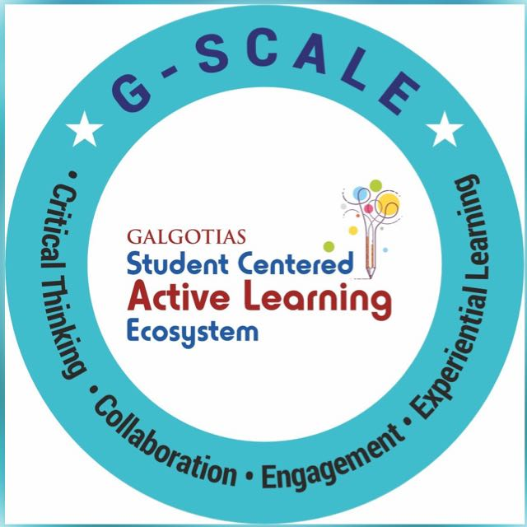

Introduction to python-History, Features
Course Name: Python Programming
Course Code: - E1UA311C
Instructor Name: Pooja Vajpayee
Duration: 50 Mins

Slide 2

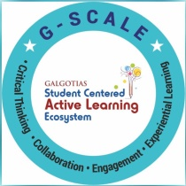
Recap
Introduction to the Course

Slide 3

Opening Question
💡 "Have you ever used a mobile app or website and wondered what programming language powers it? What do you think makes Python one of the most popular choices for developers today?"

Slide 4
At the end of this session students will be able to
Learning Outcome 1 : Explain history of Python, its evolution and areas where Python is used.
Learning Outcome 2: Describe major features and advantages of Python.

Slide 5
Session Outline
1. Introduction to Python Language.
2 . Opening and Learning Outcomes.
3. History of Python language.
4. A1 ( MCQ):
5. Features of Python language.
6 . Conclusion & Closure
7. Post Session Activity

Slide 6
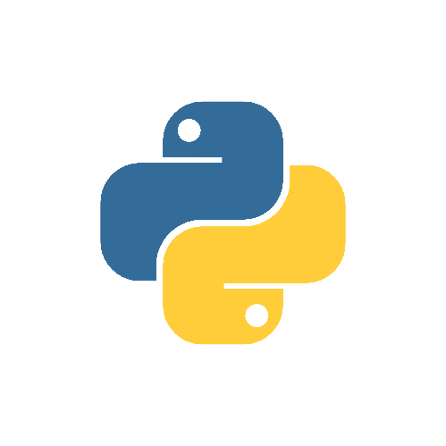
CONTENT
. What is Python
. History of Python
. Features
. Scope of Python
. Why do people use python
. Applications
. What can I do with Python

Slide 7
What is Python
.Python is high-level language.
. Python is a general-purpose programming language that in
often applied in scripting roles.
. So, python is programming language as well as
scripting language.
. Python is also called as Interpreted language.

Slide 8
History of Python
. Invented in the Netherlands, early 90s by Guido Van Rossum.
. Python was conceived in the late 1980s and its implementation was started in 1991.
. Guido Van Rossum is fan of ‘Monty Python’s Flying Circus’, this is a famous TV show in
Netherlands.
. Named after Monty Python.
. Opens sourced from the beginning.

Slide 9
Features
. Easy to Code
. Easy to Read
. Free and Open source
. Robust Standard Library
. Interpreted
. Portable
. Object-Oriented and Procedure-Oriented
. Extensible
. High-level language

Slide 10
Scope of Python
Python
Language
Web development
Chatbots
Django Framework
NLTK library
Chatbots
Selenium Automation
Data Scientist
Desktop Application
Game Developer
Robot Framework
ML and DL
Kivy

Slide 11
Why do people use python
The following Primary factors cited by Python users seem to be
these
. Python is object-oriented:-
Structure supports such concepts as polymorphism, operation
overloading and multiple inheritance.
. It’s free (open source):-
Downloading and installing Python is free and easy Source
code is easily accessible.

Slide 12
. It’s powerful:-
- Dynamic typing
- Built –in types and tools
- Library utilities
- Third party utilities (e.g. Numeric, NumPy, SciPy)
- Automatic memory management
. It’s portable:-
- Python runs virtually every major platforms used today
- As long as you have a compatible Python interpreter installed, Python programs will run in exactly the same
manner, irrespective of platform.

Slide 13
Applications
. Web Development
. Game development
. Machine Learning and Artificial Intelligence
. Data Science and Data Visualization
. Desktop GUI
. Web Scraping Applications
. Business Applications
. Audio and Video Applications
. CAD Applications
. Embedded Applications

Slide 14
What can I do with Python….?
. System Programming
. Graphical User Interface Programming
. Component Integration
. Internet Scripting
. Database Programming
. Gaming, Images, XML, Robot and more

Slide 15
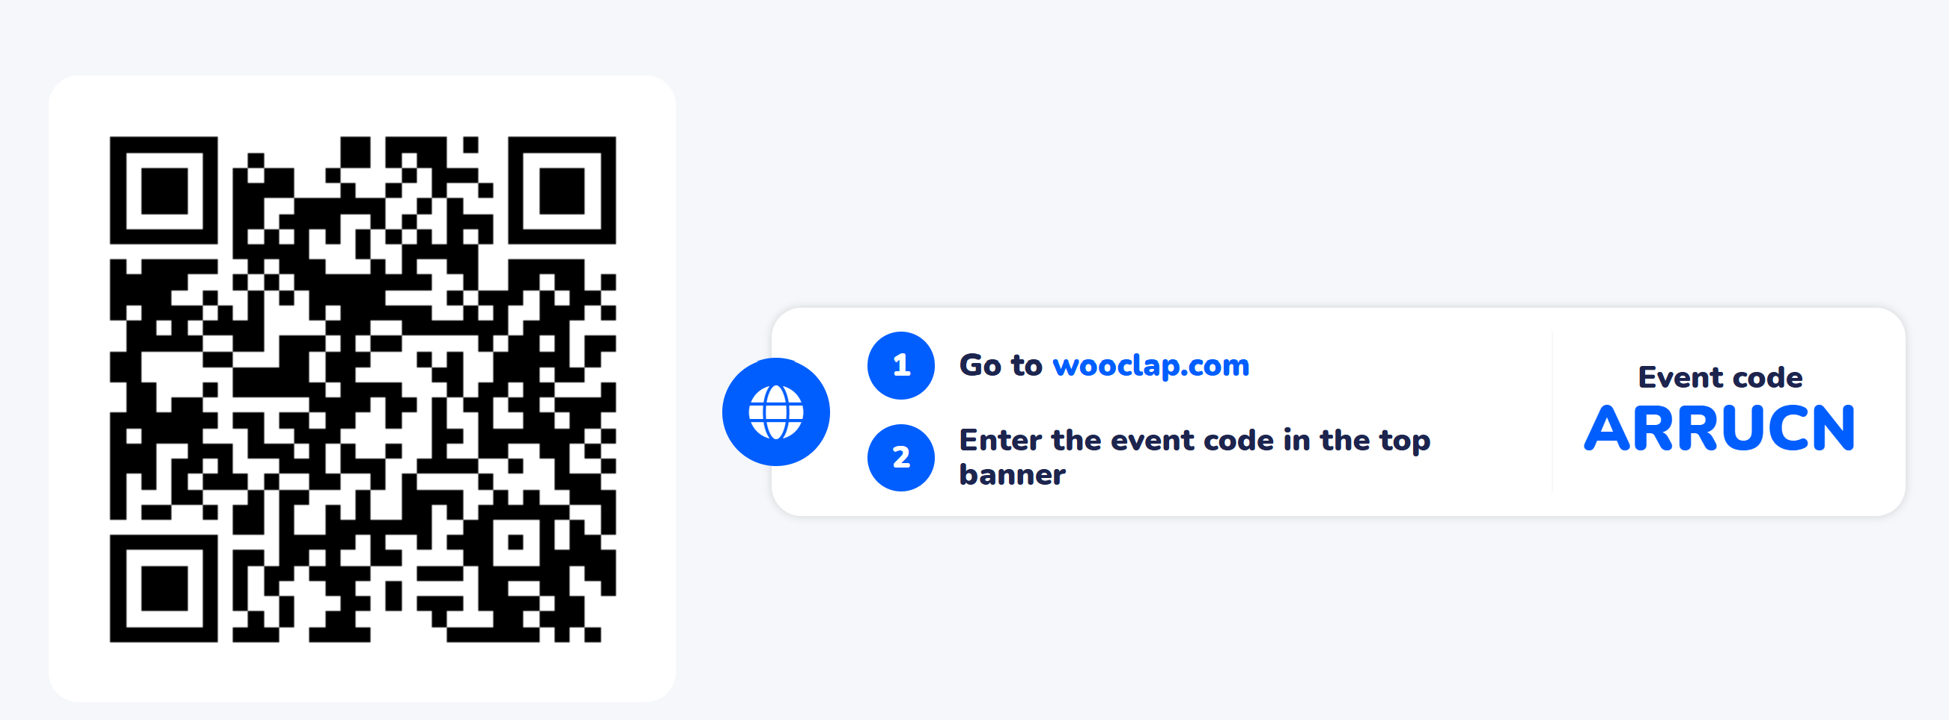
Learning Activity 1

Slide 16
Reflection-
Learning Activity 1

Slide 17
Conclusions-
✅ Python was created by Guido van Rossum in the late 1980s and officially released in 1991.
✅ It was developed with the aim of making programming simple, readable, and efficient.
✅ Being open-source from the beginning helped Python grow through global community support.
✅ Over time, Python has evolved into one of the most popular programming languages worldwide.

Slide 18
Attainment of LOs in alignment to the learning activities:
Learning Outcome 1 : Explain history of Python, its evolution and areas where Python is used.
Learning Outcome 2: Describe major features and advantages of Python.

Slide 19
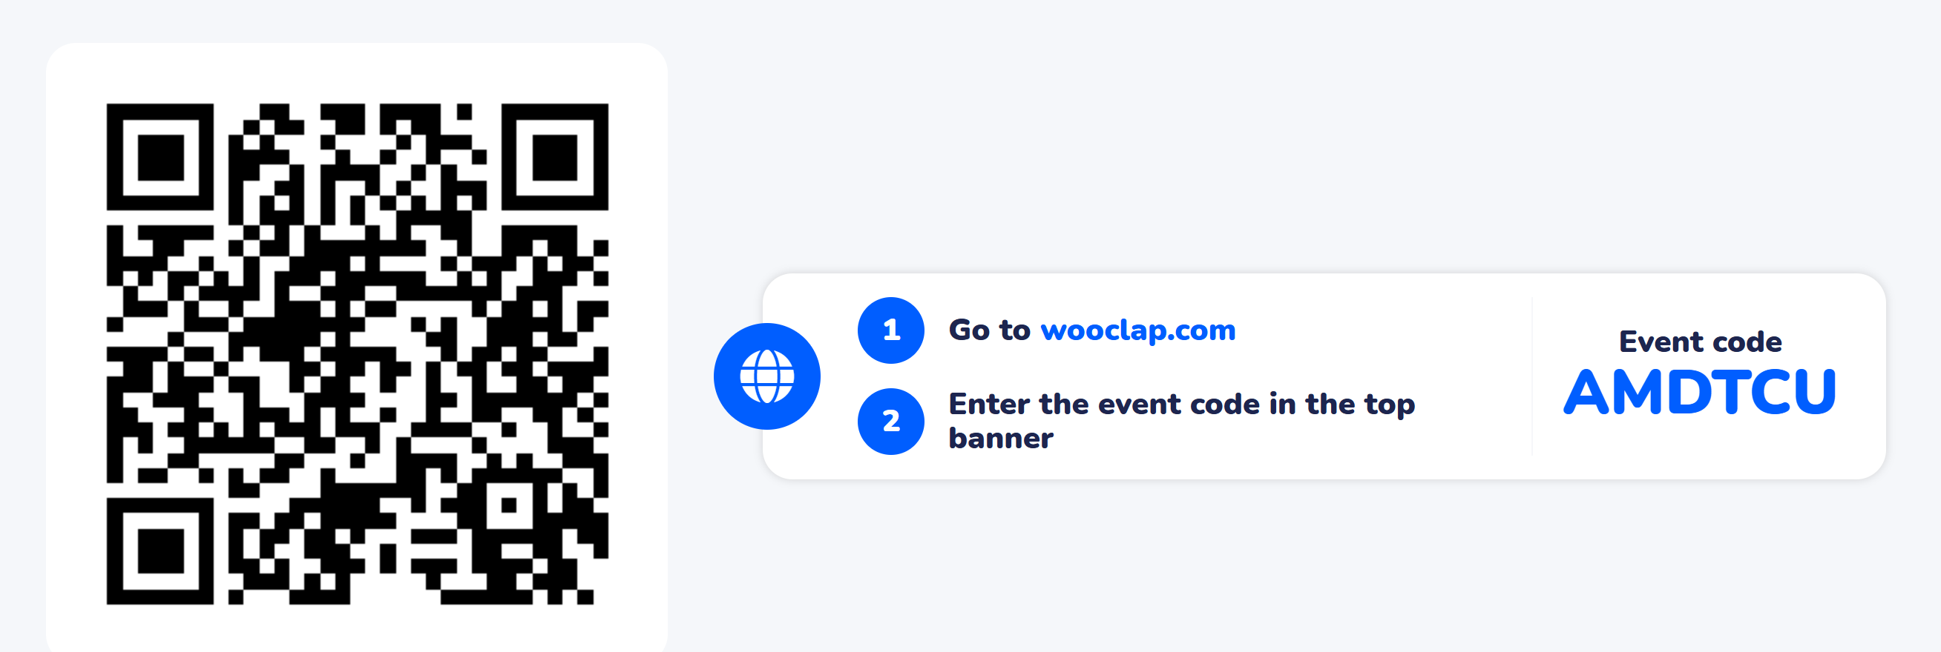
post session activities
* Attempt the Post-session activity on LMS, before next session.

Slide 20
Next session:
Syntax of Python – Writing and Running Python Programs

Slide 21

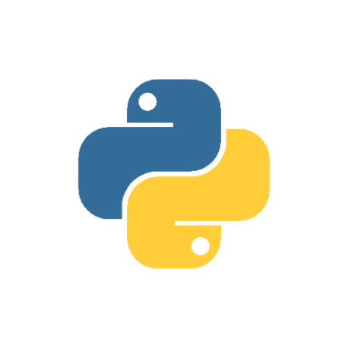
Thank You

